Slide 1


FD
FRIDAY
Easy to Learn
Hard to Master
FRIDAY
If the code and the comments do not match, possibly
Both are inccorrect

Slide 2











FRI DAY
18
BT 02 -
From IT
Data Analyze
MENTOR
Muhammad Imran
PROGRAMER
PROGRAMMER
Wandi Wardiman
ANALYZER
DESIGNER UI
Arif Widagdo
ANALYZER
Muhammad Idz
DESIGNER UI
Jonatan Jeremi Abraham Tidajoh

Slide 3









Daftar
“Pembahasan”

Slide 4


Data Cleaning
olist_order_reviews
olist_products
olist_orders
Nan
Nan
Nan
Product_height_cm 2
Review_comment_title
87657
Product_category_name 610
Order_approved_at
160
Product_widht_cm 2
Order_delivered_carrier_date
1783
Review_comment_message
58251
Product_category_name 610
Product_length_cm 2
Order_delivered_customer_date
2965
Product_name_length 610
Product_weight 2
Product_description_length 610
Product_photos_qtyh 610

Slide 5




Daftar
“Pembahasan”
Daftar
“Pembahasan”

Slide 6
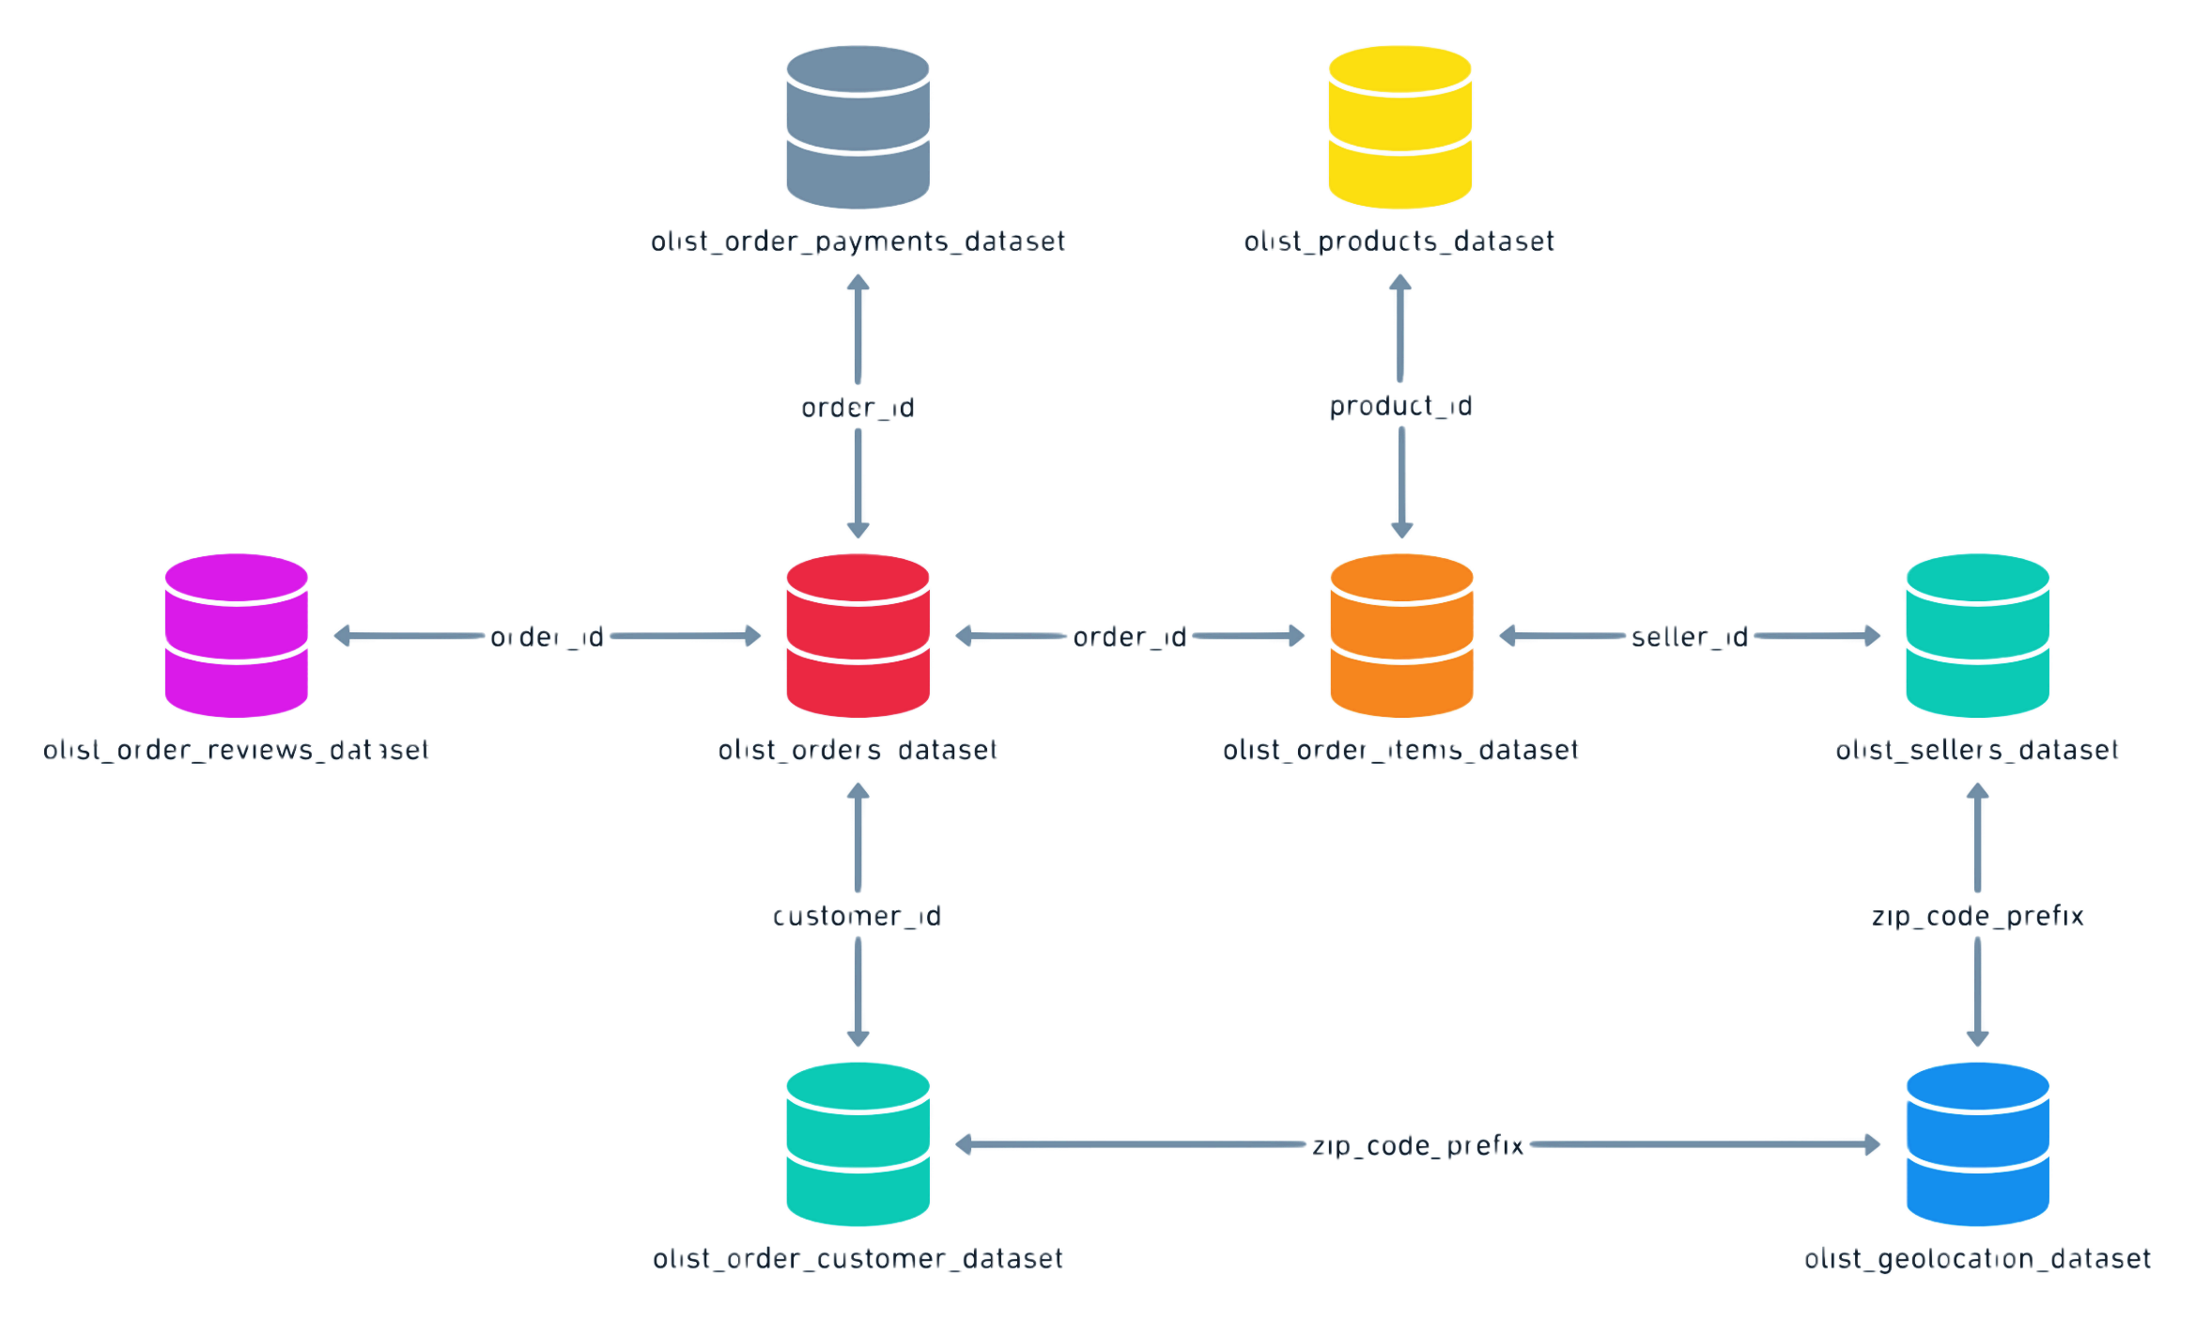
Data Integration
Olist_order_payments_dataset
Olist_products_dataset
order_id
product_id
order_id
order_id
Seller_id
Olist_order_reviews_dataset
Olist_orders_dataset
Olist_order_items_dataset
Olist_sellers_dataset
customer_id
Zip_code_prefix
Zip_code_prefix
Olist_order_customer_dataset
Olist_geolocation_dataset

Slide 7
Daftar
“Pembahasan”

Slide 8
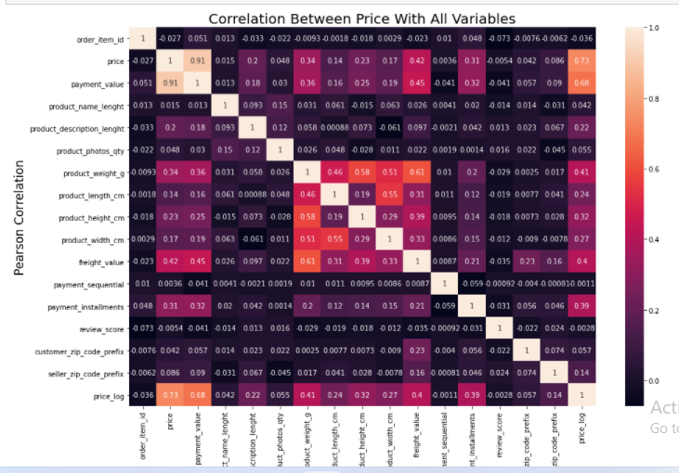
Data Visualization

Slide 9
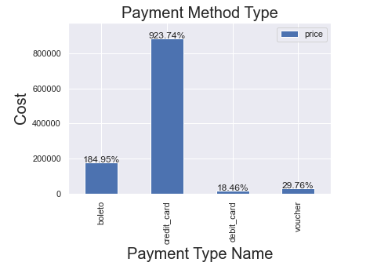
Data Visualization

Slide 10
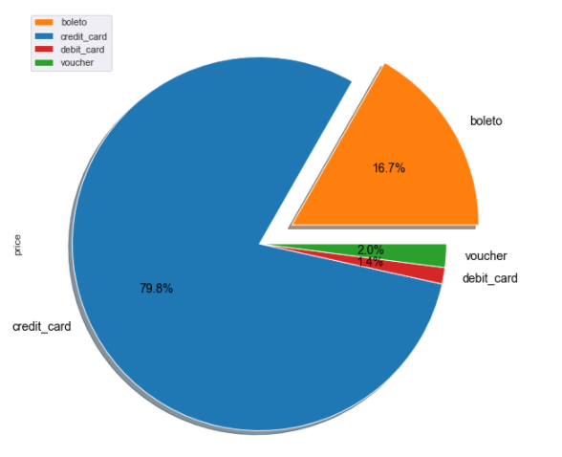
Data Visualization

Slide 11
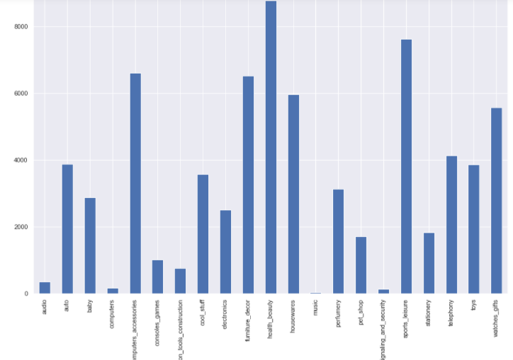
Data Visualization

Slide 12
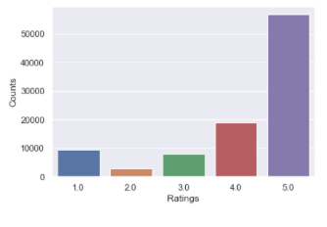
Data Visualization

Slide 13
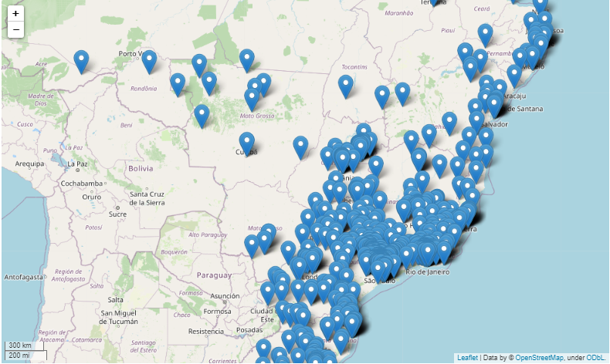
Data Visualization

Slide 14
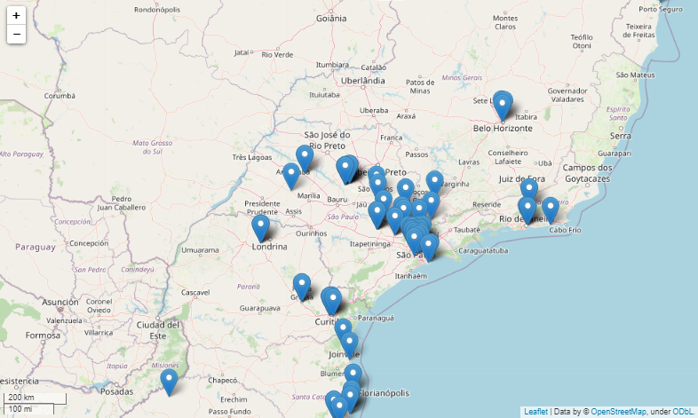
Data Visualization

Slide 15


Daftar
“Pembahasan”

Slide 16
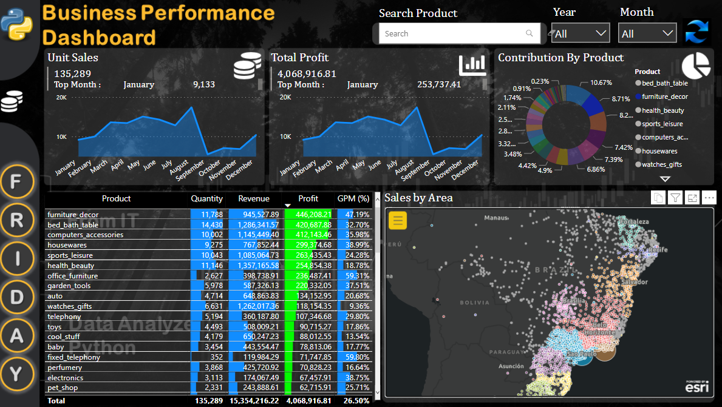
Dashboard PowerBI

Slide 17





Any Question?

Slide 18



- TERIMA KASIH -

Slide 19
PowerBi
https://app.powerbi.com/links/nIR9n6cn6q?ctid=9d384e7c-ea2c-446a-901c-a281ef1b969e&pbi_source=linkShare
Github
https://github.com/Arif-Widagdo/Data-Analysis-on-the-Brazilian-E-Commerce-Public-Dataset-by-Olist.git

